Slide 1
Working With Farmers
By Serge Koenig
Sauk County LRE Department

Slide 2
Humans are….
Emotional
Irrational
Convenience Craving
History-shaped
Reward-seeking
Meaning-making machines
COMMUNICATE ACCORDINGLY!!!!!!!!!

Slide 3
“Make me feel important”
The DEEPEST PRINCIPLE in human nature is the CRAVING to be APPRECIATED.

Slide 4
Building Trust
Knowing how to ask open-ended questions to form a connection. Starts to build trust.
Then TRULY LISTEN. Be a student of their farm. People love to teach about their operation and talk about themselves.
Try to understand your clientele.
Consider working on farms to build credibility in your farming community.
Notes:
First one needs to make a connection with producer. Humans are wired this way from birth. Ask open ended questions that get producers talking about themselves and their operation. Listen intently and follow up with open ended questions that keep them talking. If they do much of the talking, you are on the right track. Most humans like to talk about themselves much of the time. When someone takes the time to listen to them talk about themselves connections are made with that person. It’s only after this occurs that trust is slowly formed. Once trust is built people tend to be more open to new ideas and ways of seeing the world.

Slide 5
Patience
For some folks one can get to “yes” the same day.
For others, it may take 1-3 years.

Slide 6
Persistence
Don’t give up too easily but don’t overdo it.
Find that balance. Takes practice.

Slide 7
“I don’t Know”
It’s OK to say “I don’t know”.
Help get the answer in a timely manner.

Slide 8
Limit Jargon
Keep it simple.
Limit use of jargon and abbreviations.

Slide 9
Stay Calm
Important to not bolt off the farm when you are getting yelled at.
Blowing off steam before landowner calms down and actually talk with you.
Rephrase their frustration so they know you are listening and understand.

Slide 10
Art or Science?
It’s both.
Practice makes perfect……or at least better.

Slide 11
Comfort Zone
Sitting on recliner , gets comfortable, see things from the same angle, we settle in, indent the chair a bit.
Takes effort to get off the couch and move to another chair. It changes your perspective of the subject at hand but the rewards of that effort can be life changing.
Notes:
We have to get out of our comfort zones in order to grow and be more empathetic to others, EVEN IF WE DISAGREE.

Slide 12
Old Habits Die Hard
Ways of thinking and doing get hard-wired in the brain through myelination.
Those neural pathways are there forever.
We are trying to make new neural pathways and that can be VERY VERY VERY difficult. Look at your own life and way of thinking.
It’s a difficult uphill climb.

Slide 13
What’s Your “WHY”?
Know your “Why” first as a professional.
When TRUST is built through time spent with producer start asking about their “Why”.
Serge Koenig
Notes:
Why do they farm? Why continue to operate the way they do?

Slide 15
“If you don’t know where you’re going, any road will get you there.”
Gerrish

Slide 16
“If you don’t know where you’re going, how will you know when you get there?
Gerrish

Slide 17
Creating a planned future With Goals and Objectives
Notes:
A key part to success in any business, and in life itself, is to develop a set of well defined goals. Without goals you can go any direction and end up anywhere. Goals provide a destination and our objectives become the road map to take us there.

Slide 18
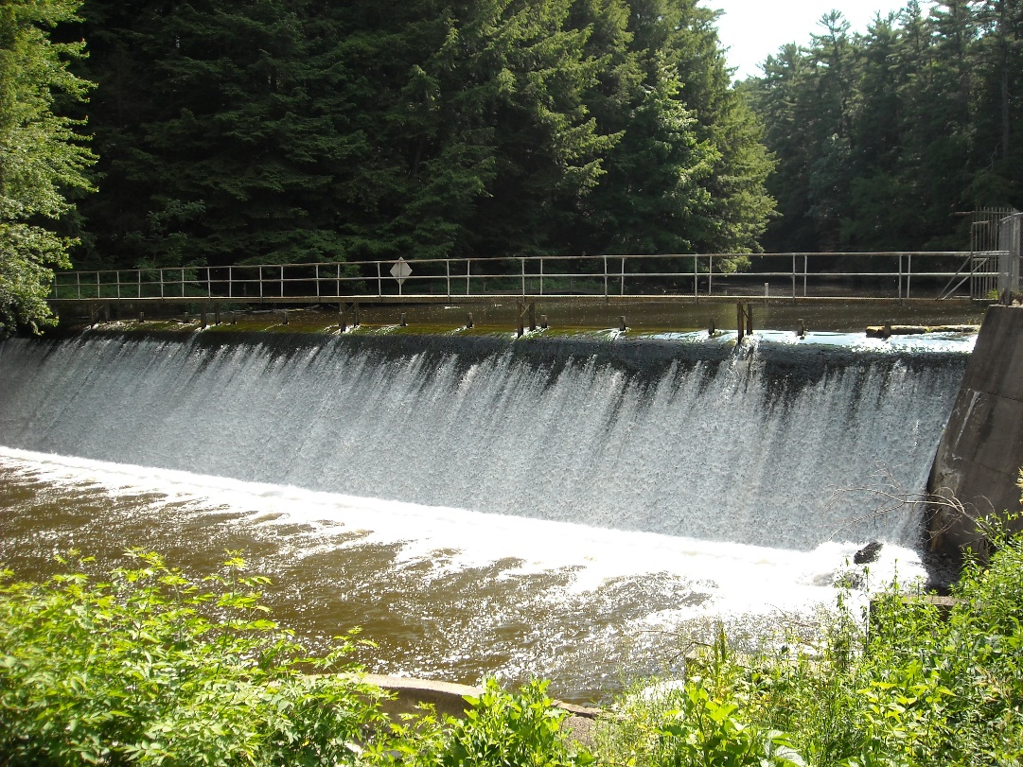
What kind of goals are important ?
Lifestyle
How do you want to live ?
Where do you want to live ?
How do you want to raise your kids if you choose to have kids ?
These are the foundation for all other choices!
Gerrish
Notes:
What kind of goals are important? Theses are the types of goals I think about. Note that none of them really concern how many cows you’re going to run or what your weaning weight target might be. They are about you, your family, and how you want to live. Those are the important things. Everything else is incidental.

Slide 19
Big Picture Visioning
Notes:
This chart helps producers to see the big picture in agriculture. They are so busy making ends meet and meeting the demands of the job that they often don’t take the time to step back. This chart helps them see the big picture. Define what agribusiness entails and how the “game” is played with all it’s “rules”

Slide 20
Education
Two items lacking in conservation education today:
1. Human psychology and sociology
2. Basic farm enterprise budget training

Slide 21
Psychology/Sociology
Conservation professionals should take a week course of human psychology/sociology.
Knowledge is worthless if it cannot be effectively conveyed to another human.
Gerrish

Slide 22
Financial
In our personal lives we ensure something makes good financial sense before making a decision to buy a car, house, vacation, etc.
Why do we expect producers to be different?
Need to know some basic enterprise budgets and how to talk about it. Practice, practice, practice.

Slide 23
Personal Touches
Pay attention to upcoming life events in producer’s life like births, deaths, equipment purchases, trips, etc.
Reach out and ask about those events.
Helps them understand that you REALLY do care about them. Relationship deepens.

Slide 24
It’s risky………………

Slide 27
We need to wear the funny hat…

Slide 29
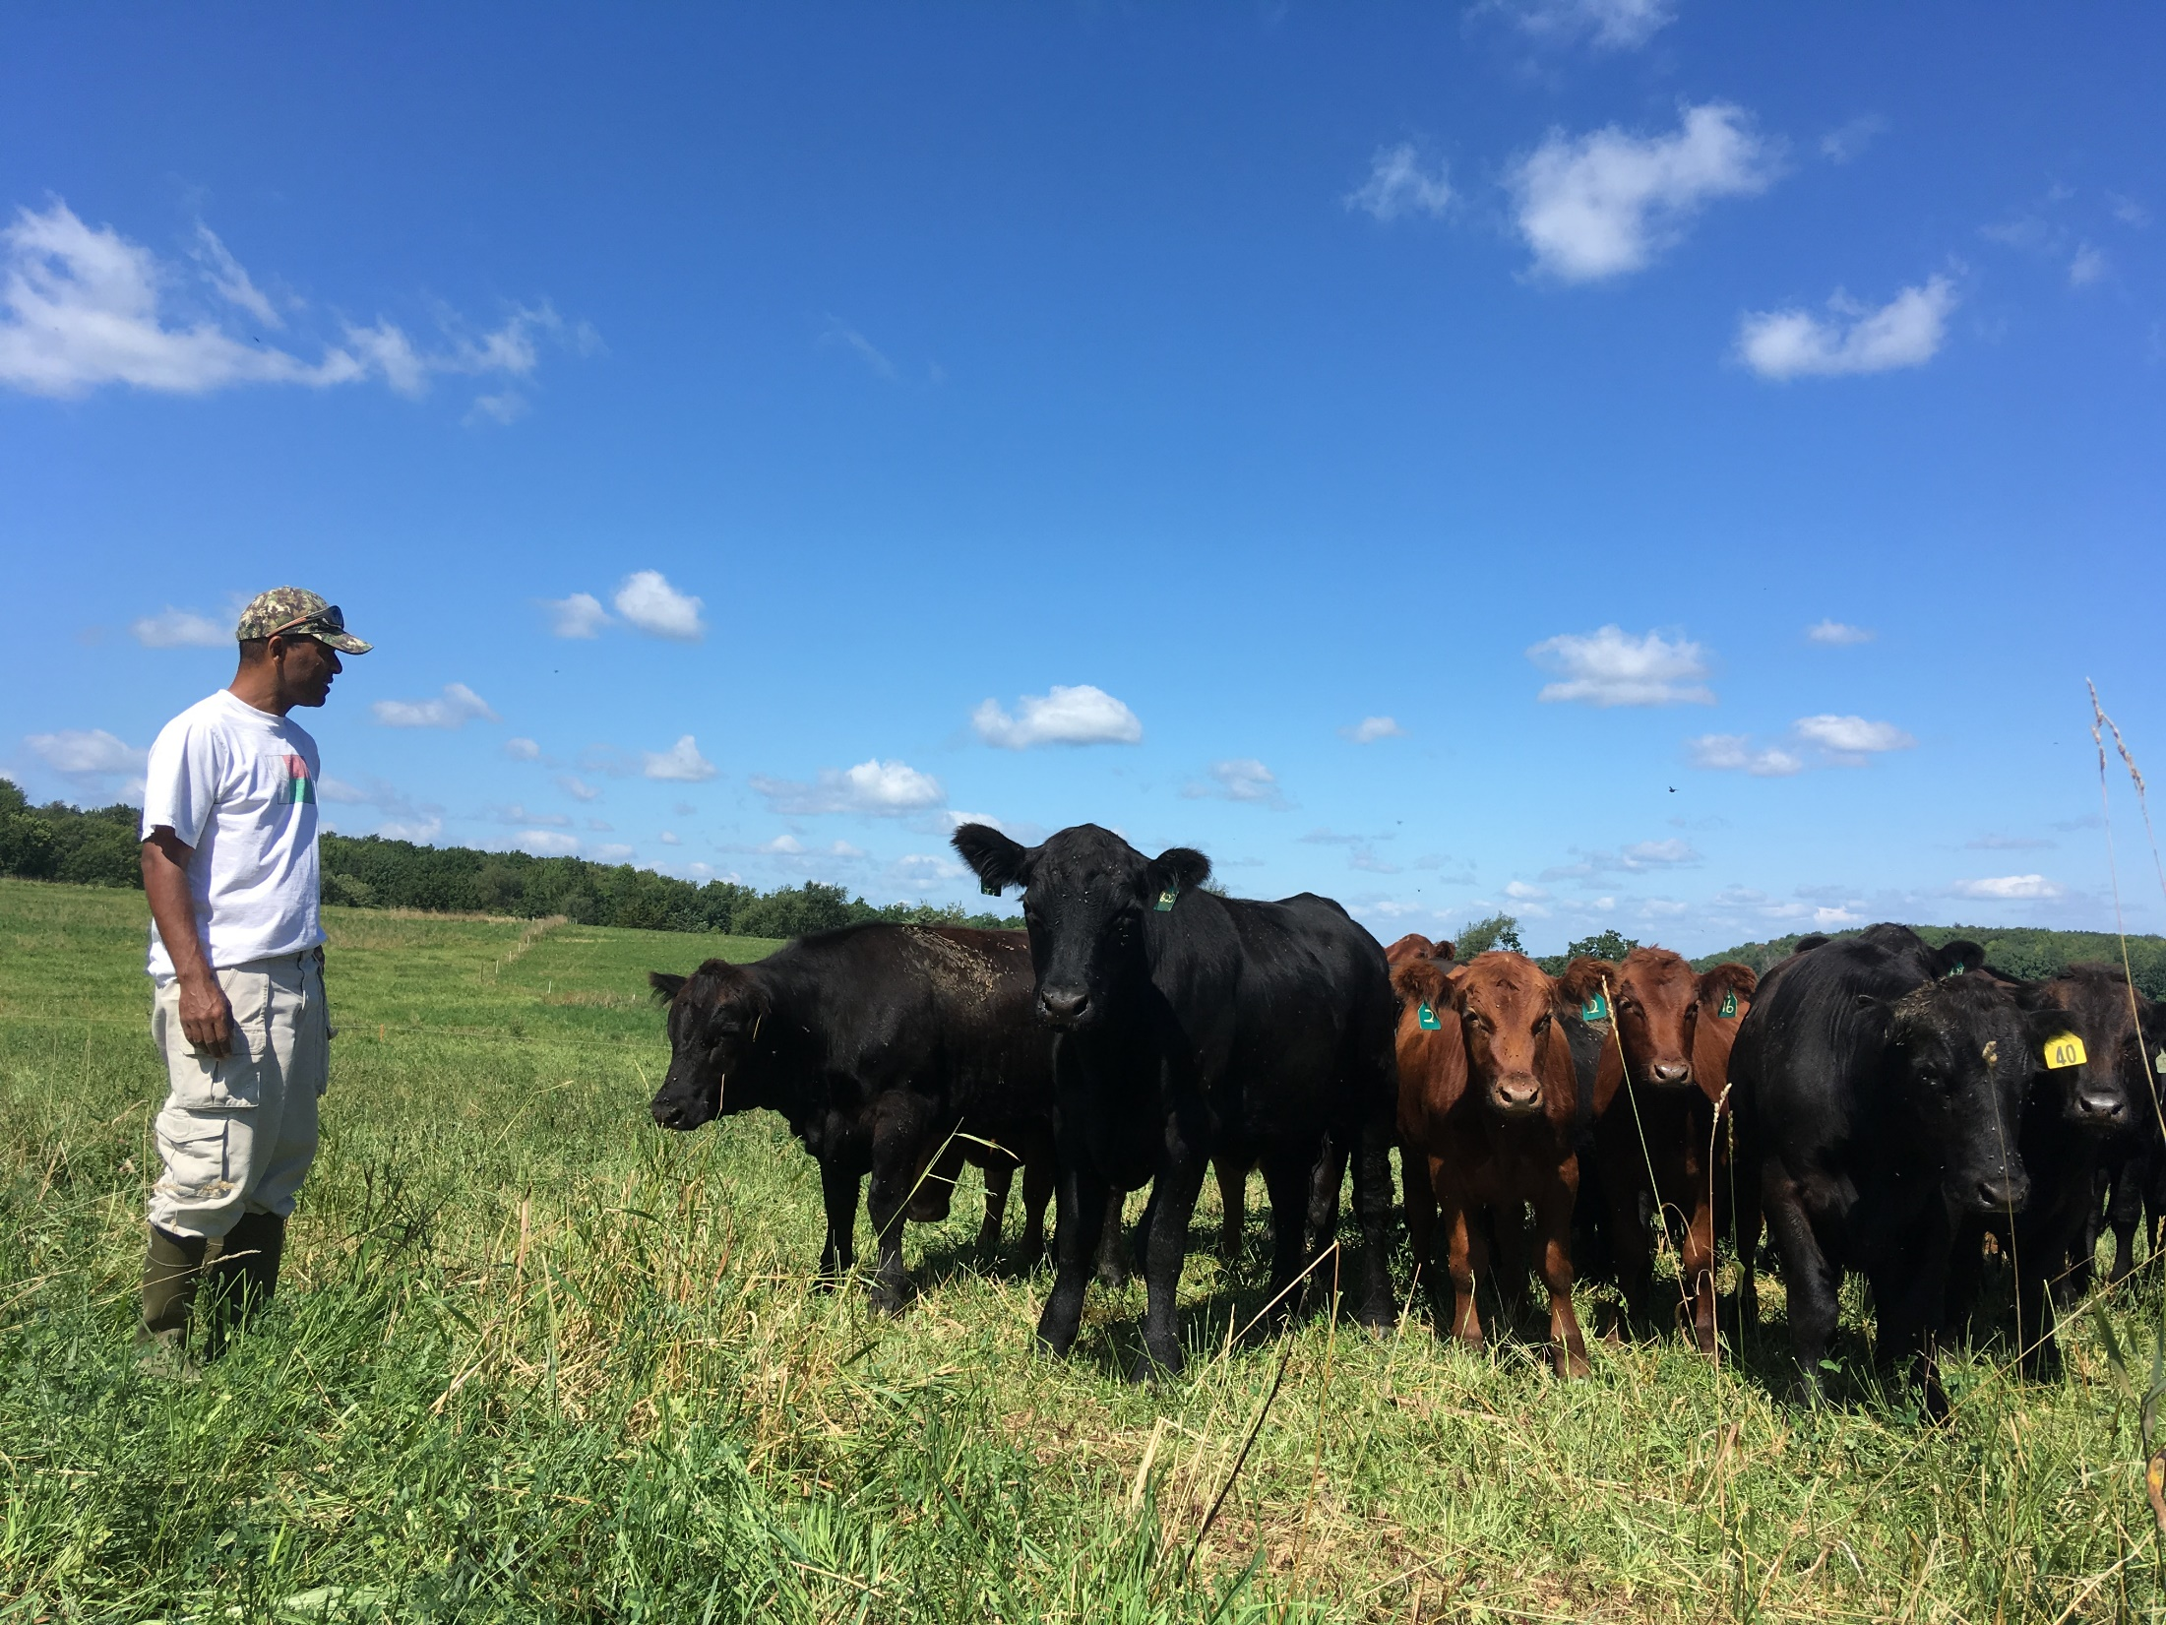
Diversity and our jobs……….exercise in perspective!!!!

Slide 30
Questions?
Serge Koenig
serge.Koenig@saukcountywi.gov
608-355-4837

