Slide 1
NRCS Planning, Programs, and Partnerships
May 18, 2023– Ryan Gerlich, acting Assistant State Conservationist - Partnerships
Notes:
GO TO VIEW > MASTER > SLIDE MASTER TO EDIT THE IMAGES ON THE TITLE AND DIVIDER SLIDES
RIGHT CLICK ON THE INDIVIDUAL IMAGES TO CHANGE THE IMAGE

Slide 2
USDA-NRCS Background
~90 years of voluntary federal and partner assistance to private landowners, beginning in 1935
Conservation assistance in Wisconsin pre-dates the agency founding through the nation’s first watershed project in 1933 in the Coon Creek watershed
Partnerships with Conservation Districts (aka LCDs and equivalents in WI), agriculture, forestry, and conservation partners is key to agency success
USDA is an equal opportunity provider, employer and lender.

Slide 3
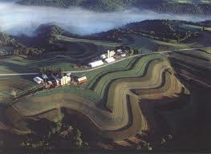
USDA is an equal opportunity provider, employer and lender.

Slide 4
NRCS Structure
Part of the USDA with roughly 10,000 NRCS employees nationwide
National Office (Chief Terry Crosby) with 4 Regional Conservationists overseeing State Conservationists
State Offices (acting State Conservationist Jeremy Bennett)
Line and Staff Structure
Programs,
Partnerships,
Easements,
Engineering,
Ecological Science/Resources,
Administrative,
Soils,
Field Operations (4)
USDA is an equal opportunity provider, employer and lender.

Slide 5
Structure Continued
Area Offices- 4 in WI (Assistant State Conservationist- Field Operations)
Area Offices provide support to Field Offices for Engineering, Resources, Programs, Soils, Biology, Grazing, Business Tools/GIS
Field Offices located in USDA Service Centers- 54 in WI overseen by District Conservationists
Field Staff often includes;
Resource Conservationists,
Soil Conservationists,
Soil Conservation Technicians,
Engineers /Civil Engineering Technicians,
Program Support Specialists,
Contracted Staff, and Partners
USDA is an equal opportunity provider, employer and lender.

Slide 6
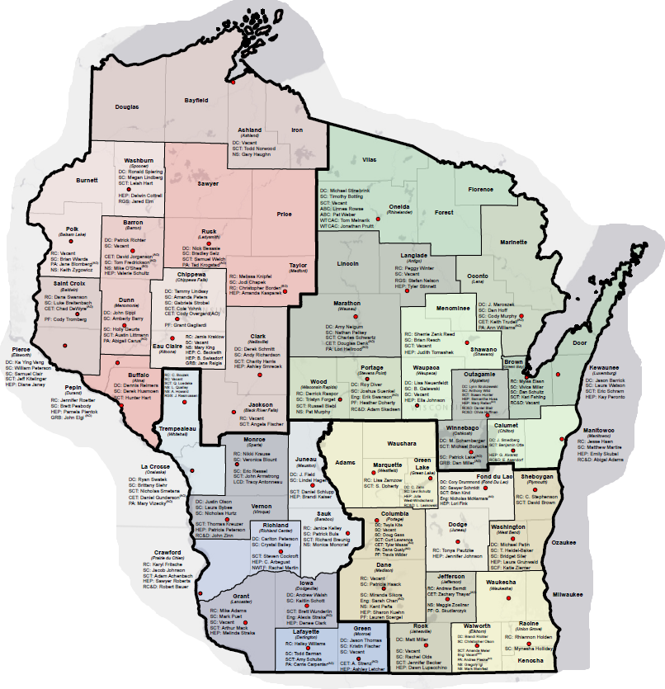
NRCS Service Center Locations
Local Service Centers | NRCS Wisconsin (usda.gov)
Or
www.wi.nrcs.usda.gov

Slide 7
How does USDA-NRCS happen?
Farm Bill (~ 5 year intervals) provides authorization
National Office develops policy, sets course for the Agency, determines funding allocations, etc
State Offices manage funding, establishes state policy, adjusts national technical standards (SOC), produces job sheets, payment schedules, etc
Area Offices and Field Offices perform conservation planning, design practices, implement programs, certify practices, process payments, and much more
All done with a great deal of help from partners
USDA is an equal opportunity provider, employer and lender.

Slide 8
Programs: Farm Bill Driven
Conservation Technical Assistance (CTA)
Financial Assistance
Environmental Quality Incentives Program (EQIP)
Conservation Stewardship Program (CSP)
Regional Conservation Partnership Program (RCPP)
Easements
Agricultural Conservation Easement Program (ACEP)
Includes ag land and wetland reserve easements
Some non-Farm Bill Authorizations
Examples; Flood Plain Easements authorized by Congress to respond to Flood disasters, PL-566 Flood Control Structures
USDA is an equal opportunity provider, employer and lender.

Slide 9
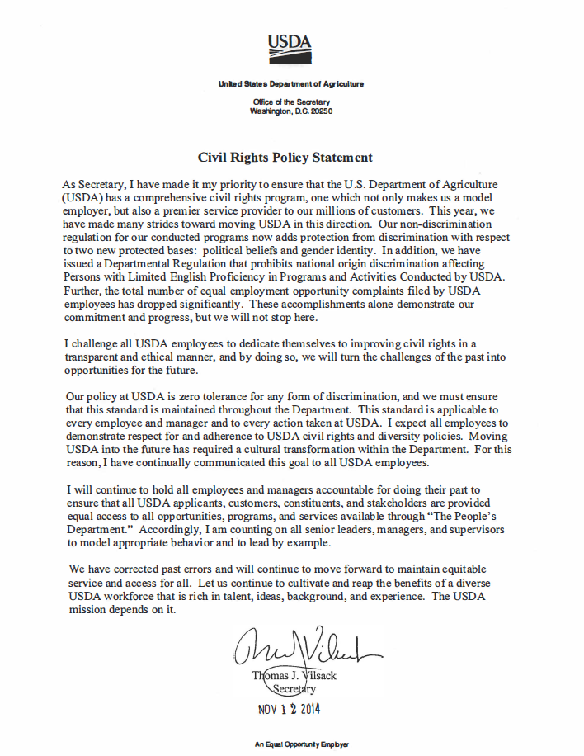
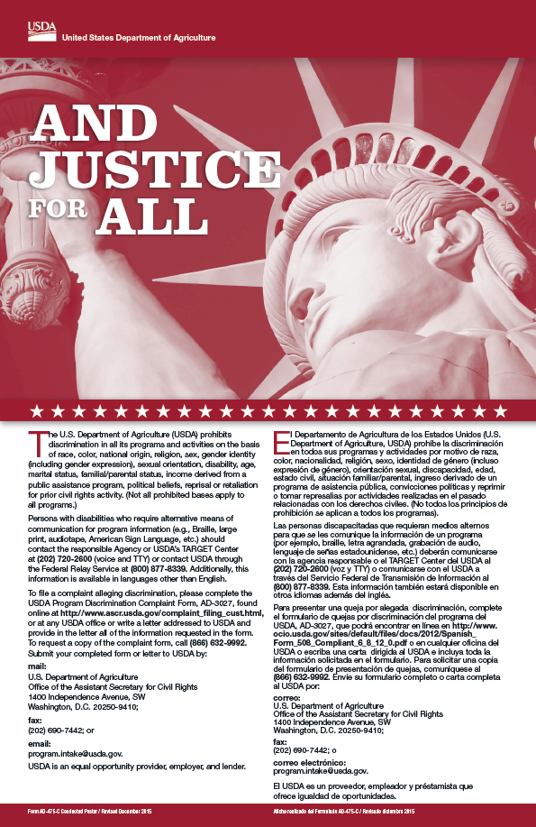
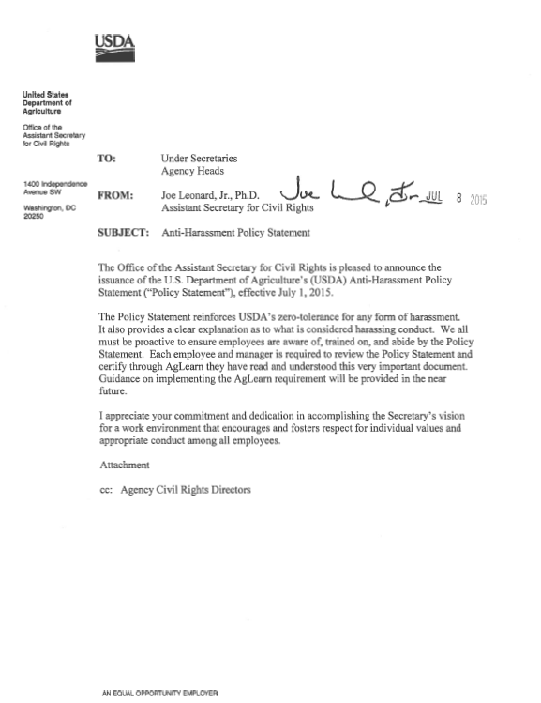
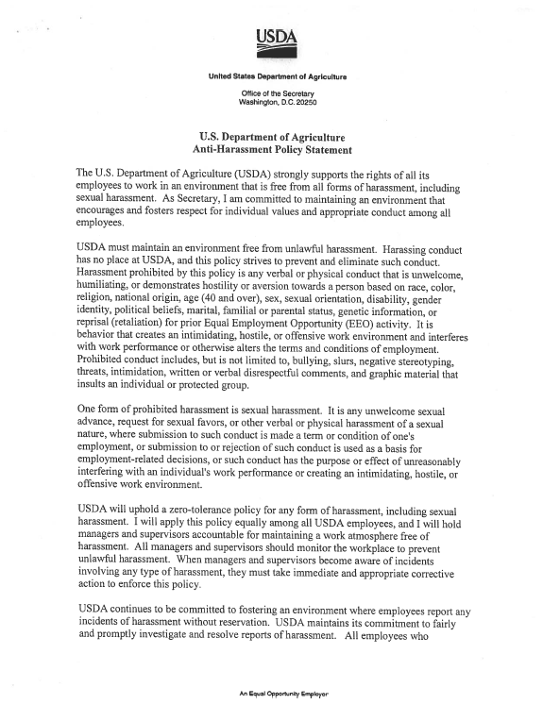
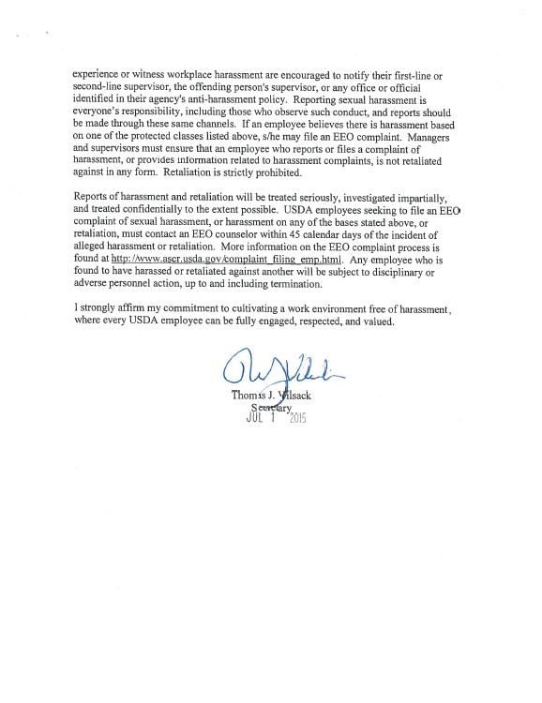
USDA Civil Rights Policy Statement
Non-discrimination regulation
Tenet of program delivery
Provide equal access to all
USDA is an equal opportunity provider, employer and lender.

Slide 10
State Technical Committee
Large membership representing the diverse group of conservation stakeholders in Wisconsin.
Members meet quarterly to advise the NRCS State Conservationist on technical and programmatic topics.
Subcommittees address specific disciplines in great detail, reporting back to the larger committee.
Wildlife,
Forestry,
Soil Health,
Source Water Protection, and
Urban and Community Agriculture
USDA is an equal opportunity provider, employer and lender.

Slide 11
Wisconsin Tribal Conservation Advisory Council (WTCAC)
Similar to the State Technical Committee, and serving 11 Native American Tribes in Wisconsin
Began with NRCS, but advises all of USDA (APHIS, USFS, FSA, ex) as well as other units of government (DNR, UW-Ex, DATCP, USACOE, ex) on tribal conservation solutions
Executive Director as well as technical staff
Stand-alone WTCAC funding in EQIP
Specialized conservation solutions
Wild rice seeding
Aquatic Invasive Species control
Fish rearing
USDA is an equal opportunity provider, employer and lender.

Slide 12
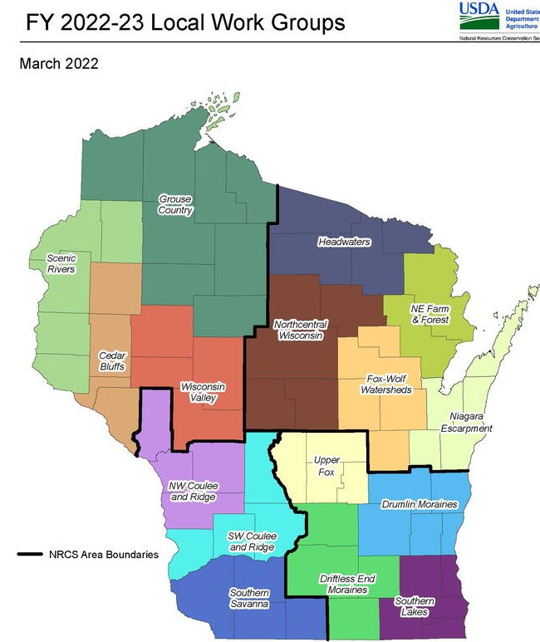
Wisconsin Local Working Groups
Typically held June -August
16 Local Work Groups
Provide local input regarding:
Resource Concerns
Practices to address the resource concerns
Opportunities for conservation,
Emerging technology,
Partnerships/new partnerships
Underserved Groups
Communication
USDA is an equal opportunity provider, employer and lender.
Notes:
Local working groups are the local equivalent of the State Tech Committee and also provide feedback to the State Technical Committee. Meet annually. See NRCS-WI website for details.

Slide 13
Environmental Quality Incentives Program
Addresses eligible resource concerns on private lands with payments for conservation practice implementation
Technical assistance is key – Planning ahead of Contracting
Involves the most conservation partners
Average 1300-1500 new contracts annually with an average of $30 M over the last 3 yr.
Many initiatives within EQIP
Sourcewater, Monarch, Mississippi River Basin Initiative (MRBI), National Water Quality Initiative (NWQI), Beginning Farmer/Socially Disadvantaged Farmer, Climate Smart Ag and Forestry, Urban and Community Ag, and many more
USDA is an equal opportunity provider, employer and lender.

Slide 14
EQIP Continued
Approximately 120 practices offered
Payment rate system utilized based on average cost
(ex. Diversion- $5.65/linear foot)
General based on 75%* of an average cost for the state/region
Planning ahead of contracting
Partner and stakeholder input is key
State Technical Committee, Wisconsin Tribal Conservation Advisory Council, Local Working Groups, Standards Oversight Council (SOC), LCDs, UW, DATCP, DNR, other federal agencies, local farmer groups, and many many more.
USDA is an equal opportunity provider, employer and lender.

Slide 15
Conservation Stewardship Program (CSP)
Rewards existing conservation activity and encourages additional improvement
Payments and eligibility included for cropland, pasture, farmstead, and forestland conservation
Like EQIP, except;
5-year contracts with payments for;
each resource concern addressed,
acres of each land use, and
payments for practices with higher payment rates for practice enhancements and bundles of enhancements
Opportunity to renew the original contract 1 time for 5 more years
~920,000 active acres enrolled
USDA is an equal opportunity provider, employer and lender.

Slide 16
Regional Conservation Partnership Program - RCPP
Elements similar to EQIP, CSP, ACEP, and CRP
Land Management and Rental Contracts (like EQIP, CSP, CRP-ish)
Entity Held Easements (like ACEP-ALE)
US Held Easements (like ACEP-WRE)
Partner-led solutions leveraging additional contributions
Scope can be multistate or local (ex. ABC-RCPP and Milwaukee River-RCPP)
Another opportunity for partners this winter.
Best to begin preparing ASAP by reviewing the past announcement and working with the NRCS program coordinator.
USDA is an equal opportunity provider, employer and lender.
Notes:
Villages, cities, counties, state government, non-profits, WWTPs

Slide 17
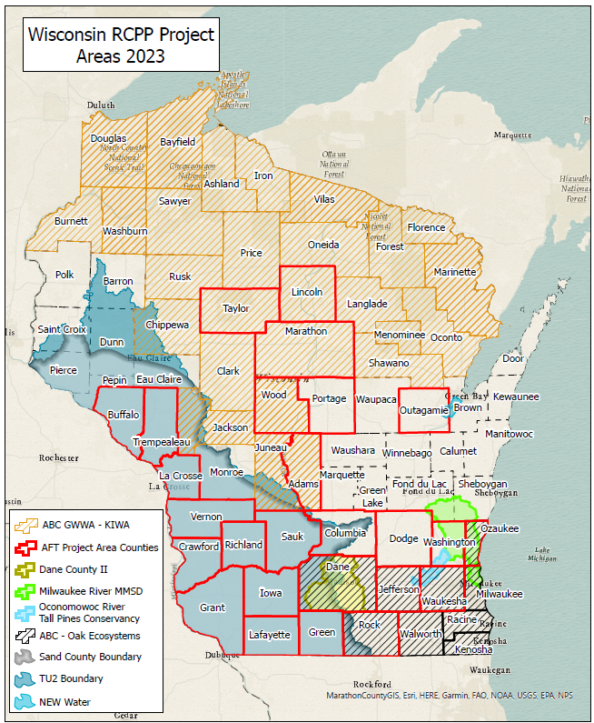
Current RCPP Projects
2023-2
59/79
Counties
8 Active Projects in Wisconsin
2 new projects coming on board in 2023
6 Completed projects

Slide 18
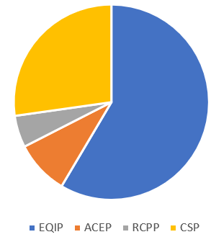
2022 NRCS Programs by the $
RCPP
$1.1 Million
64 Contracts
CSP
$15.1 Million
590 Contracts
EQIP
$33.3 Million
1,062 Contracts
RCPP
$3.0 Million
110 Contracts
ACEP (Easements)
$5.1 Million
10 Easements (Ag Land and Wetland)
USDA is an equal opportunity provider, employer and lender.

Slide 19
Emphasis on Conservation Planning
9-Step Process
Important to provide quality service to our clients who can make informed decisions (permit requirements, financial decisions, contractor availability, etc)
Key to contracts that are implemented efficiently and effectively
Communication with partners, esp. LCD is critical
USDA is an equal opportunity provider, employer and lender.

Slide 20
Partnerships
Joint efforts with wide group of conservation-focused partners.
Examples of mutually beneficial activity:
Job approval authority w/DATCP and NRCS
State Interagency Training Committee
Contribution and Cooperative Agreements (CCA)
Standards Oversight Council (SOC)
USDA is an equal opportunity provider, employer and lender.
Notes:
Counties, cities, WTCAC, DATCP, DNR, UWEX, WLWCA, RC&Ds, non-profits (PF, RGS, DU, TU, Sand County etc.)

Slide 21
Add’l Opportunities to Work Together
Regional Conservation Partnership Program (RCPP)
Conservation Innovation Grants (CIG)
Cooperative Conservation Agreements
Mississippi River Basin Healthy Watersheds Initiative (MRBI)
CRP and EQIP contribution agreements
National Water Quality Initiative (NWQI)
Demonstration Farm Networks
USDA is an equal opportunity provider, employer and lender.

Slide 22
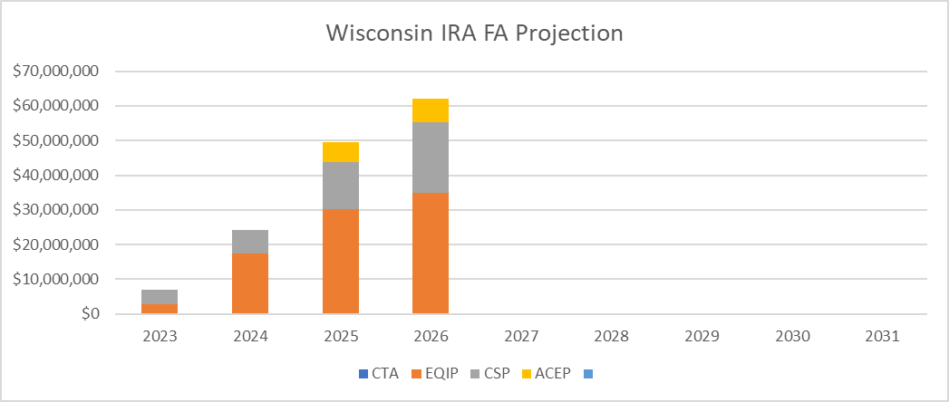
WI Financial Assistance (FA) Projection
 | 2023 | 2024 | 2025 | 2026 | FB
EQIP | $2.75M | $17.45M | $30.23M | $34.83M | ~$30M
CSP | $4.29M | $6.77M | $13.63M | $20.48M | ~$20 M
ACEP | $0 NHQ | $0 NHQ | $5.67M | $6.81M | ~$5 M
 | $7.04M | $24.22M | $49.53M | $62.13M | ~$55 M

Slide 23
Thank you!
Questions? Ryan Gerlich, acting ASTC-Partnerships
ryan.Gerlich@usda.gov ryan.gerlich@usda.gov (608) 662-4422 x227
USDA is an equal opportunity provider, employer and lender.

