Slide 1
Conservation Partnership Training
Matt Krueger, Executive Director
May 18, 2023
Notes:
Good morning. MK intro. Happy to have the chance to kick things off this morning, and welcome our spring 2023 Conservation Partnership Training cohort. Most here today come from county land & water conservation depts, some agencies, but all of us are working in the field of conservation, and are all welcome to this training that highlights and celebrates our conservation partnerships across the state.
When you all arrived, we asked you to introduce yourselves to neighbors and tell your story of how you arrived here, where you hope your story will be; make note of those people you talked to, and others in this room, as you will be going through a conservation career journey with many of them.
In kicking off this multi-day training, my hope is that I’ll be able to establish a shared understanding that doing professional conservation work in Wisconsin is a necessary and noble cause, and builds off of a rich conservation legacy that has come before us.

Slide 2
Outline
Wisconsin’s Modern Conservation History
LWCD Roles & Responsibilities
Get to Know WI Land+Water
Notes:
My role today is to share with you some information about Wisconsin’s conservation history, and hopefully orient you to your place in it, to briefly zoom in on county land & water conservation dept or LWCD roles, and provide a snapshot of WI Land+Water, the statewide organization representing county conservation.
Will build off of interaction that began when you arrived, and request your participation at points throughout my talk.

Slide 3
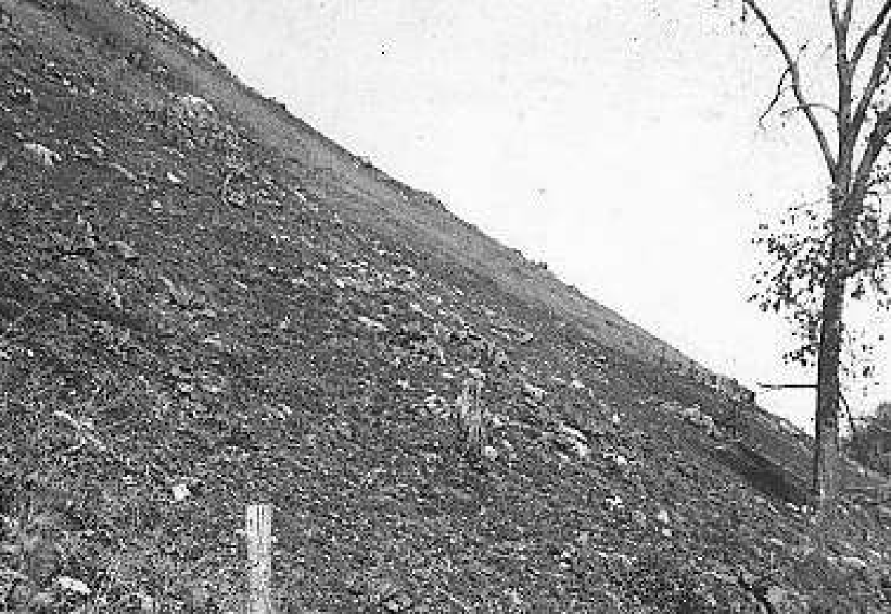
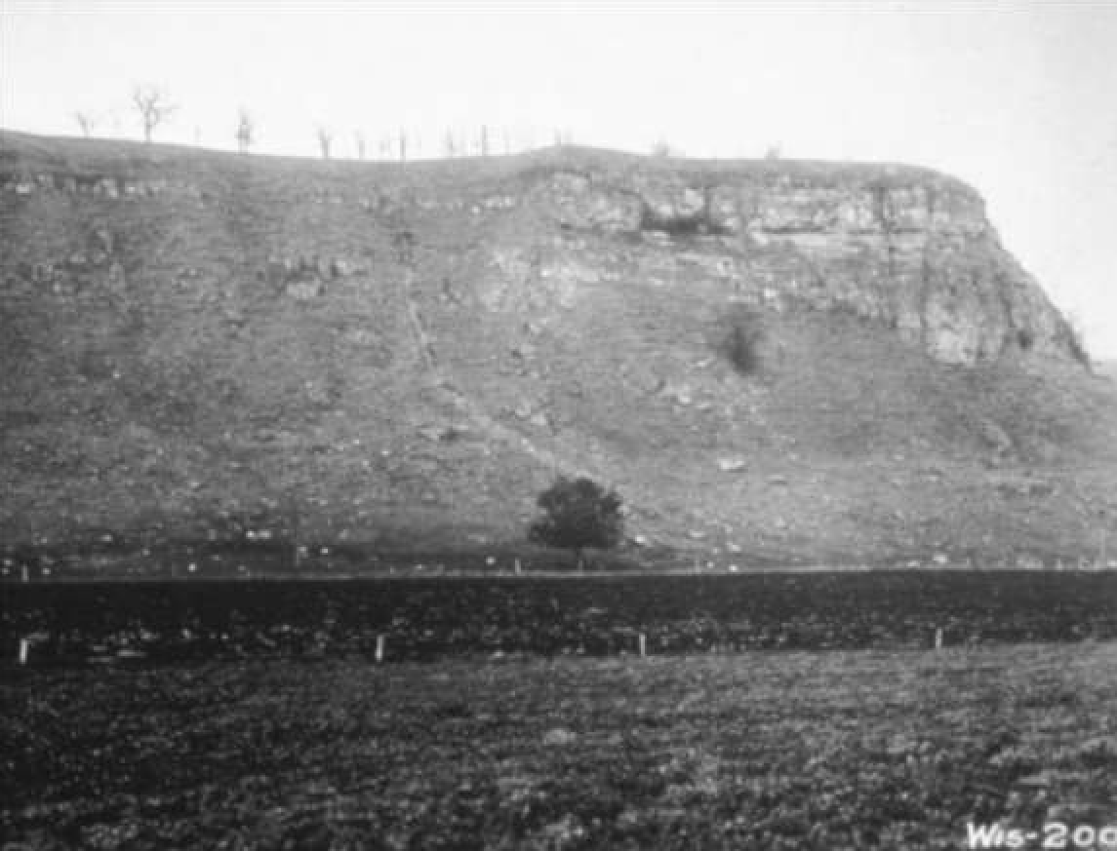
WISCONSIN’S MODERN CONSERVATION HISTORY
Less than a lifetime ago, in SW Wisconsin…
Notes:
Let’s begin by talking about modern conservation history in Wisconsin.
Native Americans were the first and original conservationists in this place we know today as Wisconsin, implementing sophisticated conservation techniques and philosophies that were far ahead of their time, some of which the broader conservation community is still learning about and learning to appreciate, today.
For the purposes of this talk, though, I am going to focus on a period of time between the 1840s-60s – wave of euro immigration to the Midwest, and Wisconsin
Farmers found the climate similar, practiced the same trad ag practices as back in northern Europe;
Trad practices: woodlots and steep hillsides grazed; pasture converted to row crops, which were heavily tilled and left bare for much of the year.
Weren’t accustomed to differences in precipitation, specifically intense storm events.
Result was massive erosion like never seen before was the result. Topsoil moved from uplands to lowlands.
80 years post-settlement, landscape looked like the moon.

Slide 4
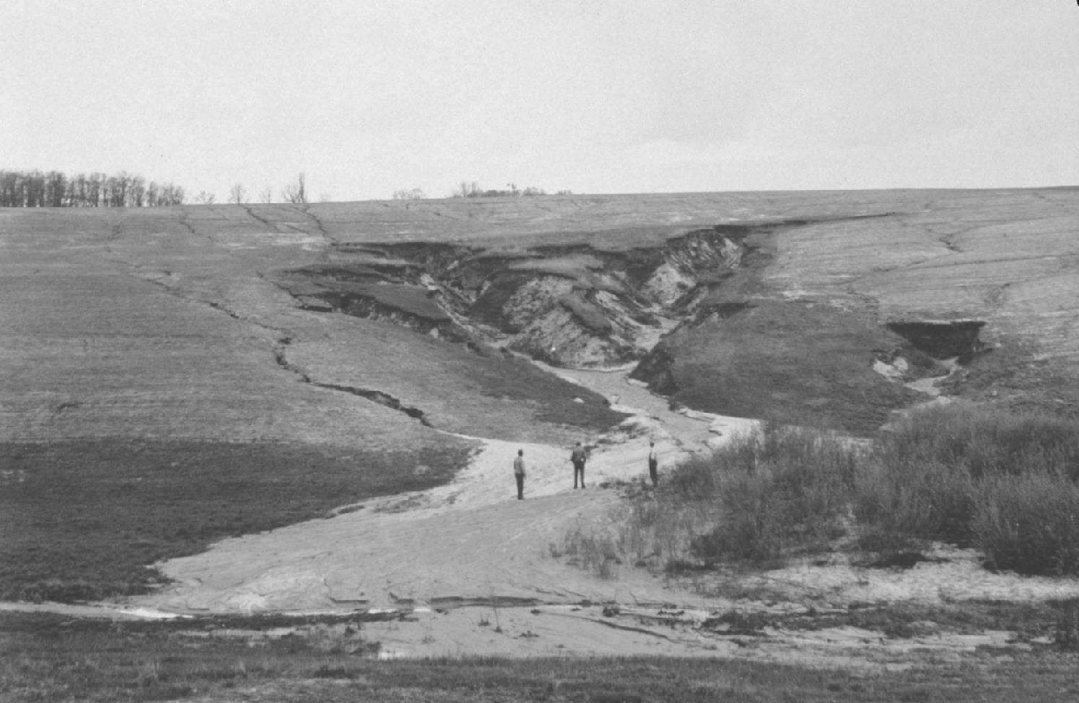
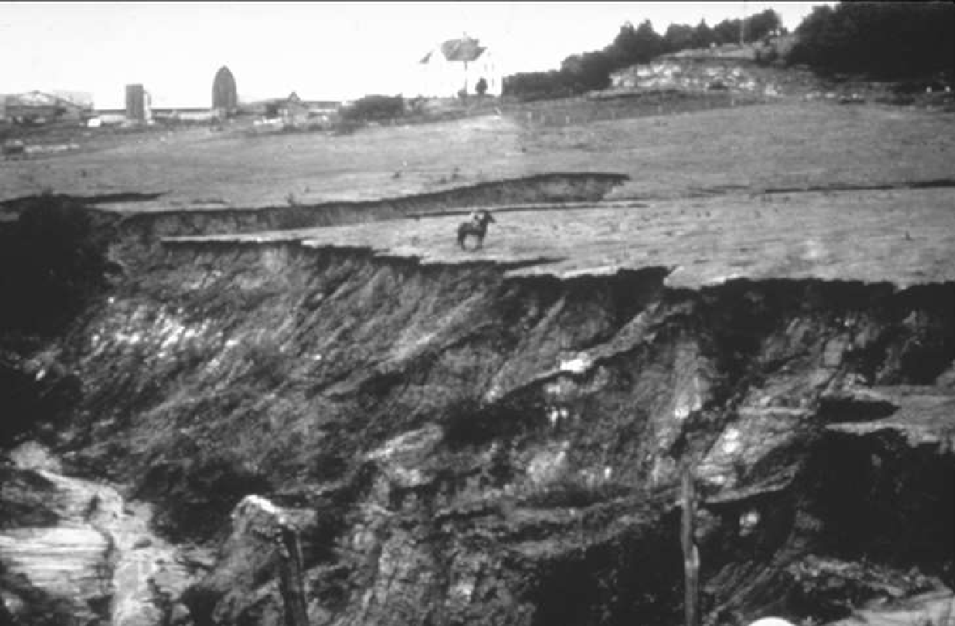
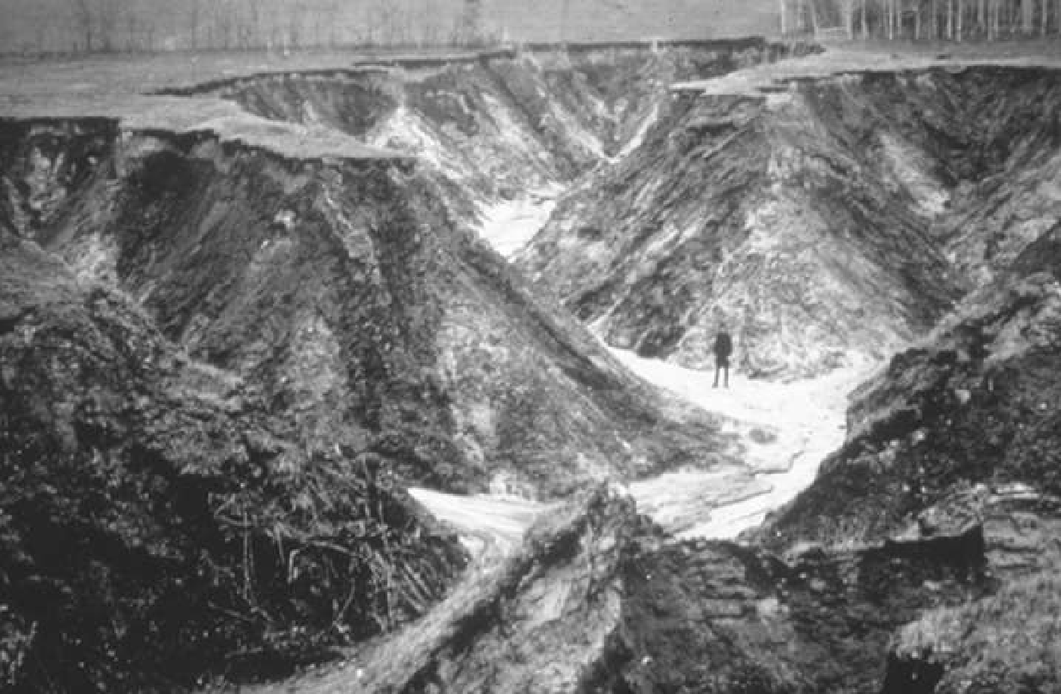
Notes:
(Animations)
Photo 1 (men in field): Pigeon Creek in Jackson Co WI (1938)
Photo 2 (man in gully): Trout Run in Monroe Co (1937)
Photo 3 (man on horseback at gully edge): Jackson Co (1938)
Gully advanced ¾ mile, ate up 80 acres; road moved 6 times
Photo 4 – sediment deposition
Erosion wasn’t just a farm issue, it was an issue that affected public and community health, infrastructure, and local economies.

Slide 5
Question:
If the conservation story of the mid 19th and early 20th centuries is one of soil erosion, what issue or issues will define the story of conservation in our century? What are the challenges you see us facing now, or going forward?
(Please state your name and affiliation when answering)
Notes:
Raise han

Slide 6
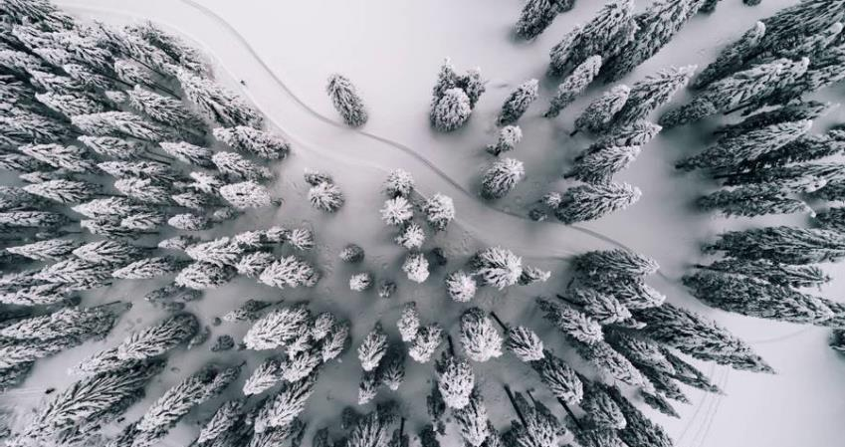
Conservation challenges
CLIMATE CHANGE – a challenge like we haven’t faced before…or maybe we have?
LIMITED RESOURCES – both human, and financial
POLITICS – obviously…
WATER QUALITY – increasing number of impaired waters, increasing public consciousness
TURNOVER – shorter staff tenure today than previous generations

Slide 7
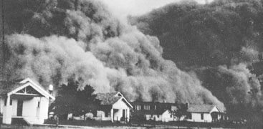
Born of the dust bowl
Federal government creates the Soil Erosion Service (SES). Coon Creek Watershed Project initiated.
1933
SES replaced by Soil Conservation Service (SCS), the precursor to the USDA-NRCS
1935
Wisconsin replaced Conservation Districts with county Land Conservation Committees (LCCs)
Conservation districts created in 1937 to support SCS
1982
1937
Conservation districts in every county in Wisconsin; WACD formed
1953
1930
1940
1950
1960
1970
1980
1990
2000
2010
2020
Notes:
So a generation’s worth of accumulated erosion and runoff issues from farming techniques that displaced a lot of soil (in Wisconsin and across the country) were creating issues, and then were followed by years of drought, and the Dust Bowl. The federal government had to respond, and their response will eventually lead us to where we sit today.
1933 – erosion issues plaguing WI leads to formation of SES, and as means of public employment. Coon Valley, WI in Vernon Co, WI leads the US on conservation in establishing first watershed project in the country.
Revegetated uplands, fenced cattle out of streams, rotated crops, planted along contours
1935 - Consec yrs of Grt Plains drought, on top of erosion, results in dust storms, some of which reached as far south as TX and as far east as NY.
HH Bennett, testifies to Congress under blackened sky from dust storm that had traveled from KS.
Congress passes legislation declaring soil & water conservation a national policy, creating the Soil Conservation Service (SCS).
Leopold begins restoring sand farm in Sauk County
1937 – Conservation districts formed to support SCS, and were in every WI county by 1953; WACD formed – 1st early incarnation of WI Land+Water!
1982 – formation of LCC – provided conservation apparatus with a direct link to local funding sources, decision-making, employment, and coordination with zoning
Another example of WI conservation leadership and innovation. Wisconsin is unique in this case.

Slide 8
LWCD Roles & responsibilities
Chap. 92 requires all counties create a land conservation committee (LCC) to conserve soil, water, and related natural resources. Also specifies authorities and makeup of LCCs; directs LWCDs to create and implement a land and water resource management plan.
Notes:
Transition to the roles and responsibilities of LWCDs; the foundation for which is Chapter 92, which is our Soil and Water Conservation and Animal Waste Management Law. It contains important information about the authorities, roles, and responsibilities statutorily provided to Land
In straightforward language, Section 92.02 declares soil erosion and resulting nonpoint source water pollution in the state to be “endangering the health and welfare of the state's citizens, its recreational resources, agricultural productivity and industrial base.”
It continues on to declare it the policy of the state “to halt and reverse the depletion of the state’s soil resources and pollution of its waters.” These are powerful declarations, and provide strong backing for the shared work of LCCs and LWCDs.
The statute also contains important soil and water resource management information outside of the scope of LCCs: LWCB, DATCP’S SWRM program

Slide 9
EXERCISE:
For each of the following conservation roles & responsibilities, raise hand for each one that falls within your current or anticipated job duties or work priorities.
Notes:
These are county responsibilities, but more broad than that. And note who raises their hand at the same time you do—these might be people with whom to compare notes in the future.

Slide 10
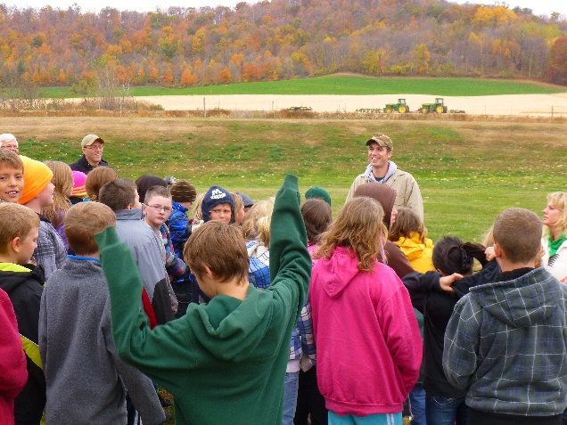
CONSERVATION roles & responsibilities
Conservation planning or project design
Providing technical assistance or cost sharing to landowners/farmers
Providing information & education services to communities
Monitoring water quality/quantity (surface & groundwater)
Administering contracts, permits, programs
Implementing a county ordinance
Developing partnerships with fellow counties, interest groups, organizations, agencies, etc.
Notes:
What did I miss?
These are important roles. Note who else around the room anticipates their work

Slide 11
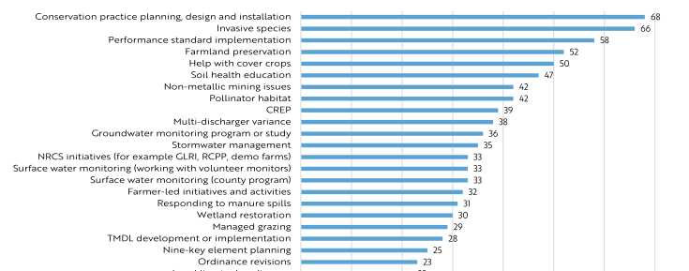
County engagement on conservation topics*
* 2021 DATCP Report on Soil and Water Conservation

Slide 12
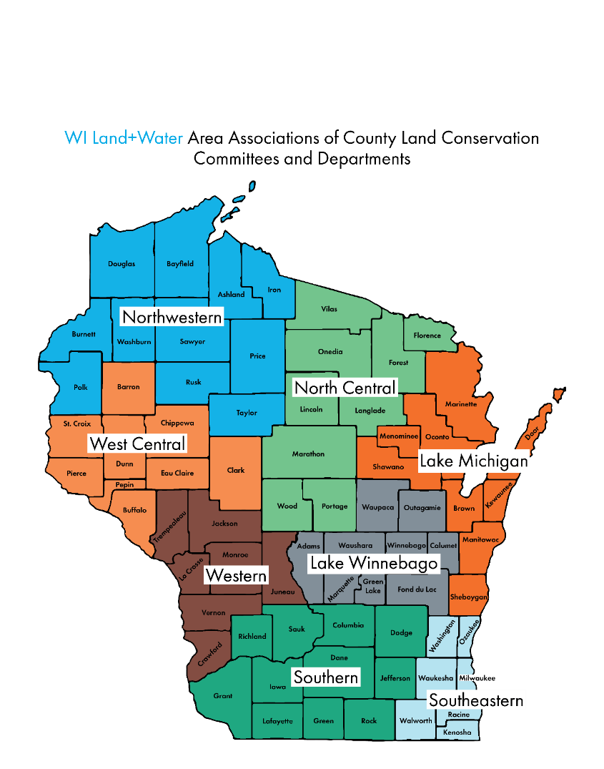
WI Land+Water
Non-profit, non-partisan 501(c)(3) supporting the efforts of 450 Land Conservation Committee (LCC) members and 380 Land and Water Conservation Dept (LWCD) staff in Wisconsin.
Established in 1953 to connect 72 county land conservation programs.
Merged with WALCE in 2012
2023: all 72 counties are members
Professional staff of eight (and one intern) based out of Madison office, work statewide
Area associations form our structure
Conservation Partnership Training

Slide 13
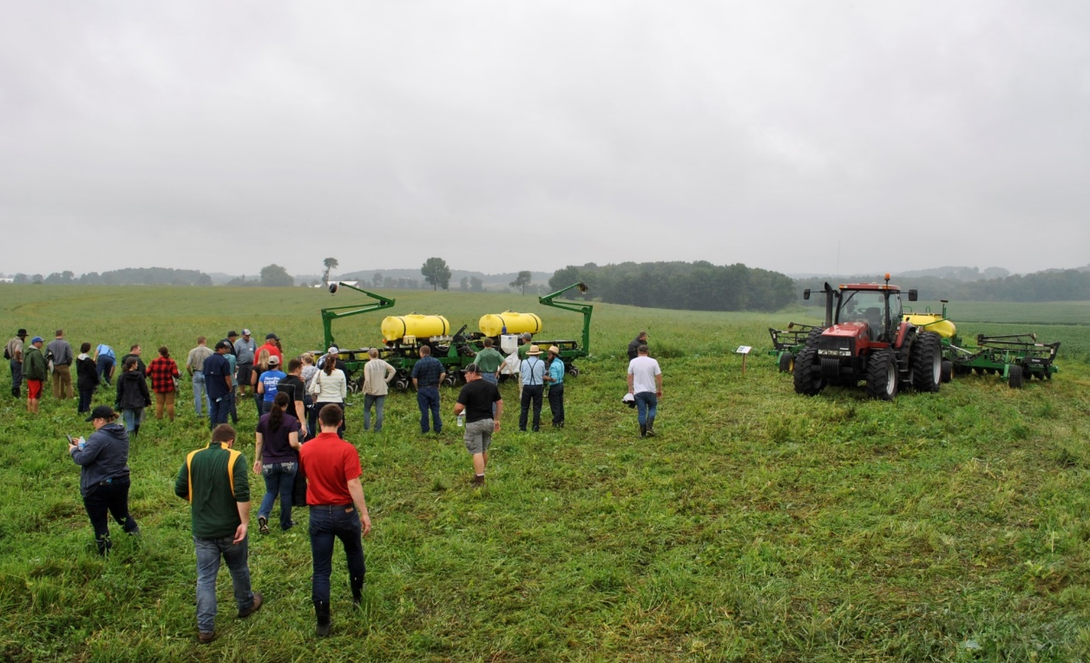
leadership
Governed by a Regional Board of Directors from Eight Area Associations
16 Board members, two from each of the 8 areas (1 LCC, 1 LWCD)
6 Executive Committee members, 4 officers + 2 at-large members
2022-2024 Executive Committee:
Pres./Vice Chair – Bob Micheel, Monroe
Chair/Vice Pres.– Monte Osterman, Racine
Treasurer – Amy Piaget, Dane
Secretary – Carolyn Scholl, Vilas
At-large member – Melissa Luck, Richland
At-large member – Ken Gerhardt, Clark

Slide 14
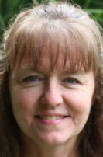
WI Land+Water Staff
Represent county conservation members in statewide policy and legislative matters; oversee operations
Provide conservation training opportunities that enhance professionalism of conservationists
Help counties build resilience against climate impacts
Protect soil and water by facilitating development of sound conservation technical standards
Increase awareness through conservation success stories
Educate youth about conservation
Conservation Partnership Training
Notes:
WLW serves as our “boots on the ground” in Madison to help advance locally-led conservation.
Services/staff rundown:
Work closely…: MK advocating, lobbying for budget, policy
Prof improvement/cons training: big part of our work. PP - trainings, CS - conf
Climate Resilience Prog - CA
Coop among agencies…: KB – SOC
Increase support…: KT – Communications (newsletter, success stories, etc.)
Youth Ed: KW – youth camps, envirothon, poster and speaking contest.
Each staff is a liaison offering support to our 7 committees

Slide 15
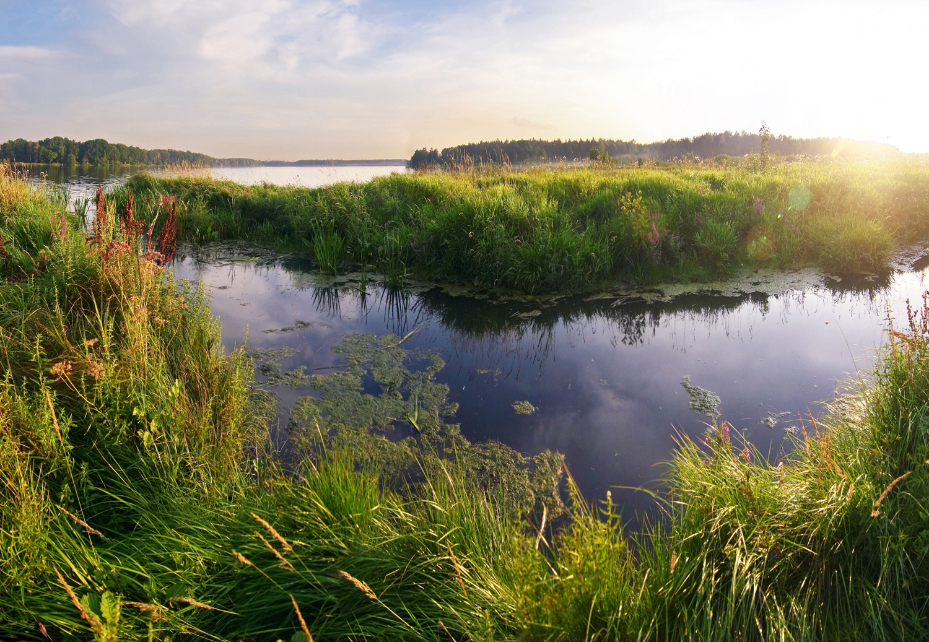
Wi land+water committees
LWCD/LCC experts, doing important work
Great Lakes
Legislative/Administrative
Mississippi River Basin
Professional Improvement
Public Outreach
Technical
Youth Education
Health & Conservation Working Group
Notes:
Our committees do vital work, and are important ways to not only build your own professional development, but to contribute meaningfully to the direction and priorities of WI Land+Water.

Slide 16
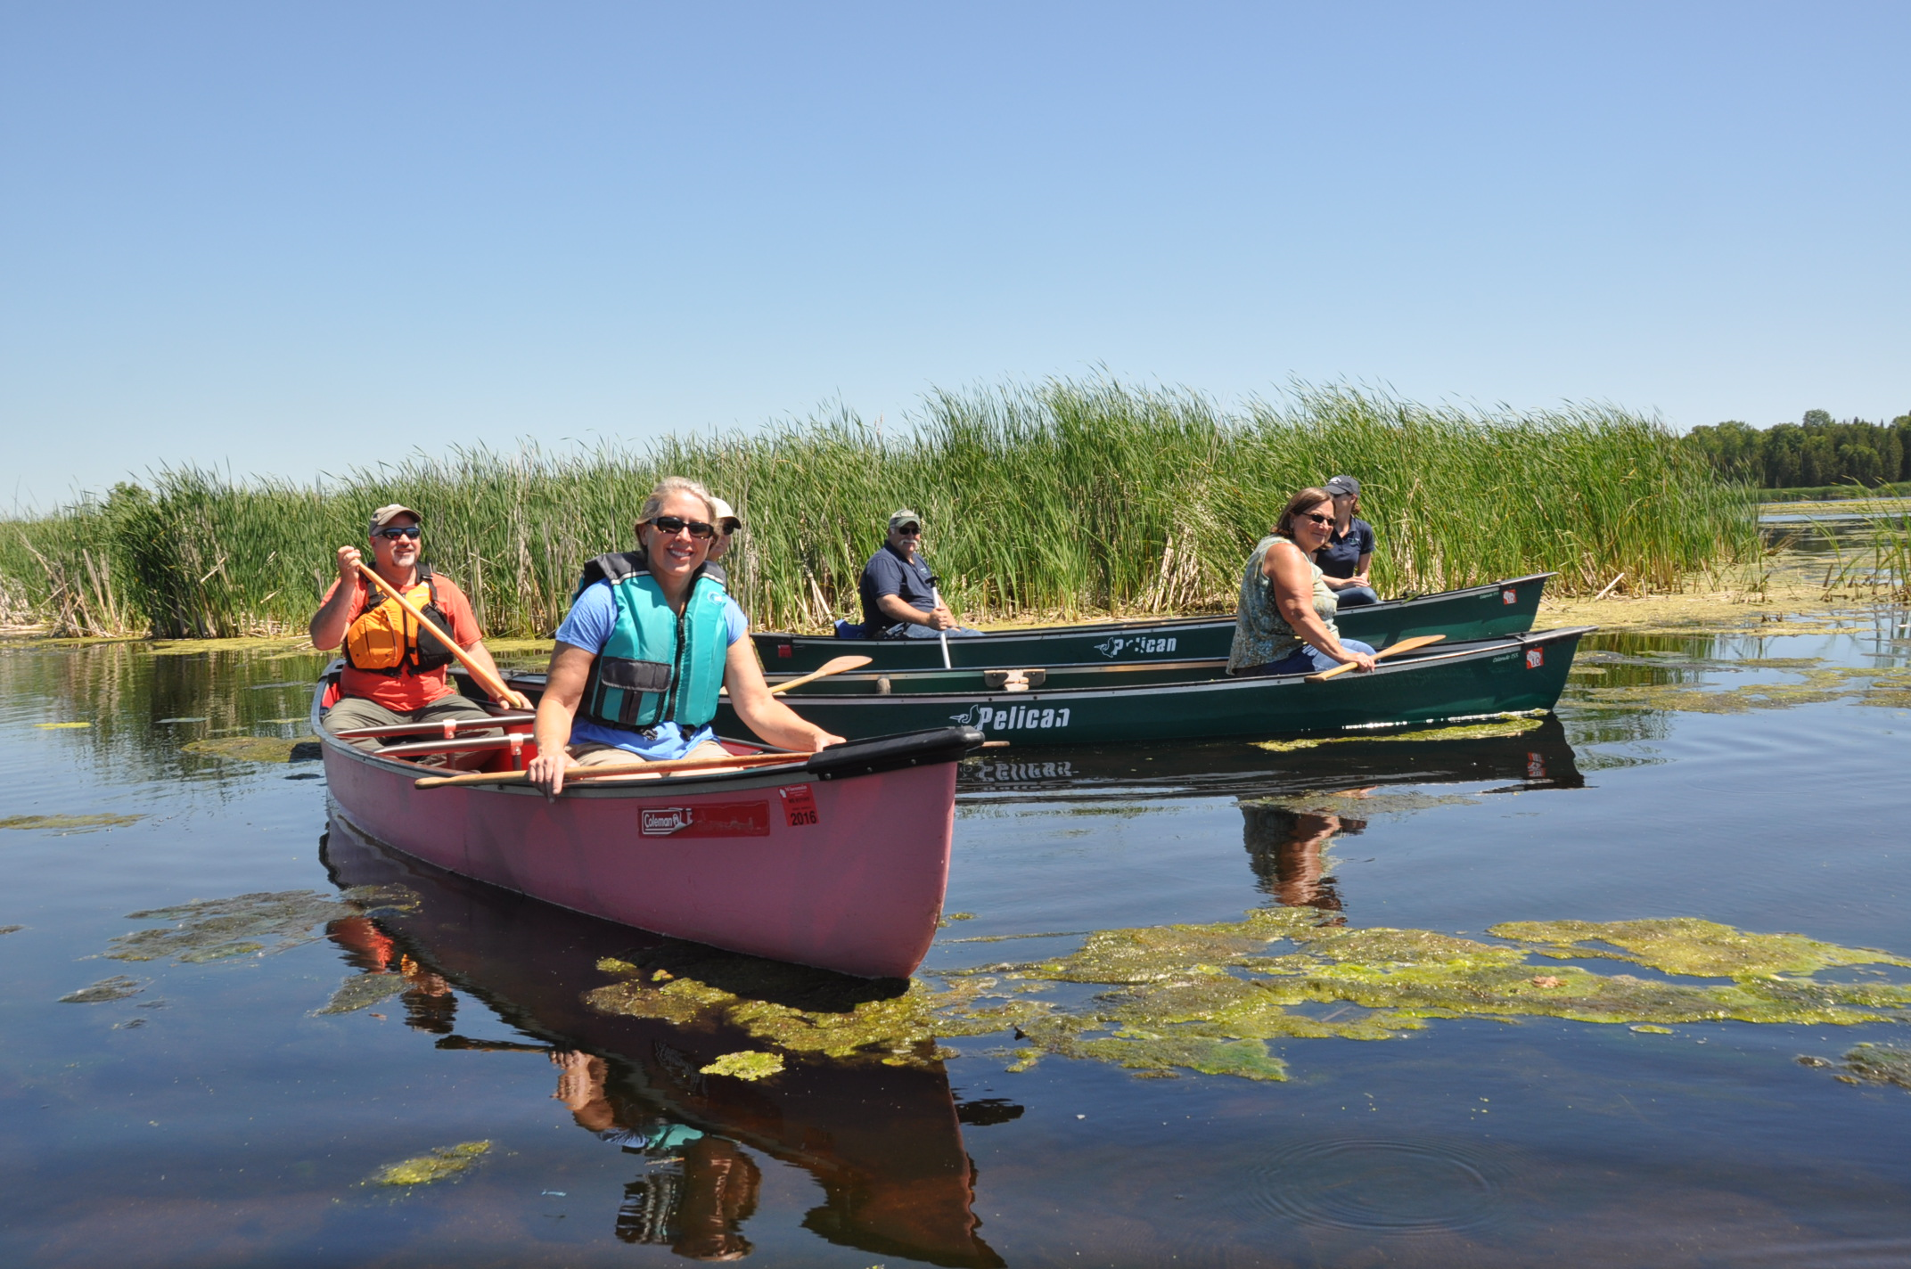
Get involved
Many opportunities to engage!
Learn more about (or join) a committee
Participate in local Area Association meetings or summer tours
Share a Conservation in Action story
Learn about our collective conservation training needs and priorities
Attend the WI Land+Water Annual Conference (Mar 6-8, 2024, Green Bay, WI)
Notes:
We’re only as strong as our membership! Lots of opps to get involved
Area Assn – peer-to-peer learning
Success stories
Trainings issues

Slide 17
Get involved – WE MEAN IT!
Many opportunities to engage!
Learn more about (or join) a committee – TALK TO MATT
Participate in local Area Association meetings or summer tours – TALK TO ISABELLE
Share a Conservation in Action story – TALK TO MATT
Learn about our collective conservation training needs and priorities – TALK TO MICHAEL
Attend the WI Land+Water Annual Conference (Mar 6-8, 2024, Green Bay, WI) – TALK TO MICHAEL
Notes:
We’re only as strong as our membership! Lots of opps to get involved
Area Assn – peer-to-peer learning
Success stories
Trainings issues

Slide 18
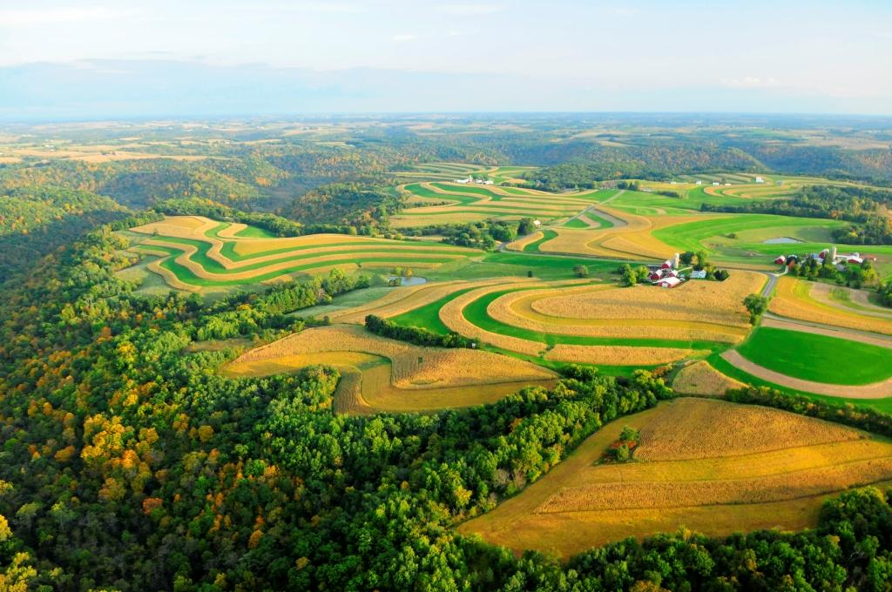
From this…
to this.
Notes:
I want to close with a reminder that we have seen challenges on an unprecedented level before. It wasn’t long ago that our rural landscape looked like this.
But in the course of a lifetime, with strong conservation leadership and infrastructure, led at the local level, it changed into something that looks more like this.
We are lucky to have you on board, and we welcome you to roll up your sleeves, strap on your boots, and get to work with us!

Slide 19
Questions?
matt@wisconsinlandwater.org
wisconsinlandwater.org
Notes:
If we have time…

