Slide 1
Wisconsin Nonpoint Source Program
Karl Gesch | Nonpoint Source Program Coordinator
Wisconsin Department of Natural Resources
Conservation Partnership Training | May 18, 2023

Slide 2
DNR nonpoint source regional coordinators
Terry Kafka
715-498-0432
Terence.Kafka@wisconsin.gov
Ruth King
715-416-0266
Ruth.King@wisconsin.gov
Temporary vacancy
Erin or Mike Gilbertson
Mike.Gilbertson@wisconsin.gov
Liz Usborne
715-590-2877
Elizabeth.Usborne@wisconsin.gov
Erin Hanson
920-360-7845
ErinE.Hanson@wisconsin.gov
Cindy Koperski
608-792-3725
Cindy.Koperski@wisconsin.gov
Jesse Bennett
414-458-0448
Jessiah.Bennett@wisconsin.gov
Temporary vacancy
Cindy, Jesse or Mike Gilbertson
Mike.Gilbertson@wisconsin.gov
UNPS grants: Dan Bekta, 608-333-6579, Eugene.Bekta@wisconsin.gov
https://dnr.wisconsin.gov/topic/Nonpoint/NPScontacts.html

Slide 3
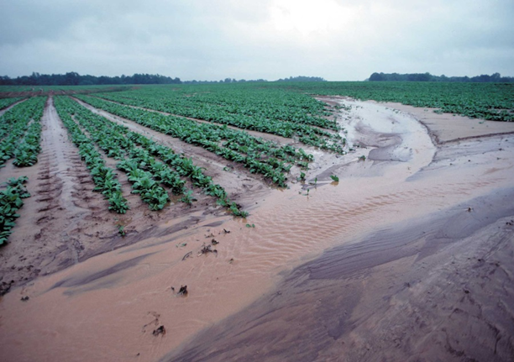
Nonpoint source pollution = not from a point source.
Point source pollution is regulated by permits.
NPS pollution includes runoff from agricultural, rural, and urban land.
Agricultural storm water
Irrigation return flows
NPS pollutants include:
Nutrients
Sediment
Others (oil, bacteria, pesticides, salt)

Slide 4
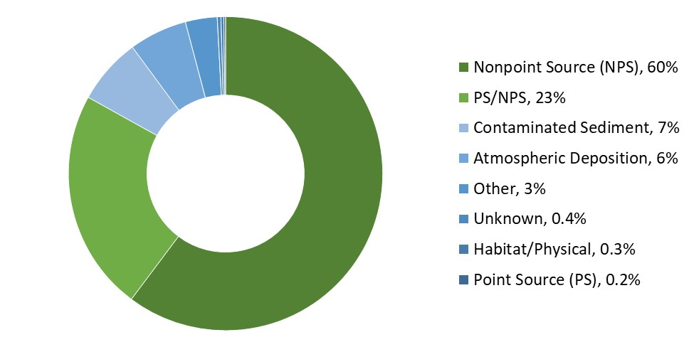
Nonpoint source (NPS) pollution is the leading cause of water quality impairment in WI.

Slide 5
Wisconsin’s NPS program is built on interagency collaboration.
Wisconsin NPS Program
Counties
Implementation
DATCP
The “how”: practice standards
DNR
The “what”: performance standards

Slide 6
DNR’s NPS program functions include:
Planning
Watershed plans
Standards
Agricultural performance standards
Funding
Grants and cost-share
Tracking
Practices & water quality monitoring

Slide 7
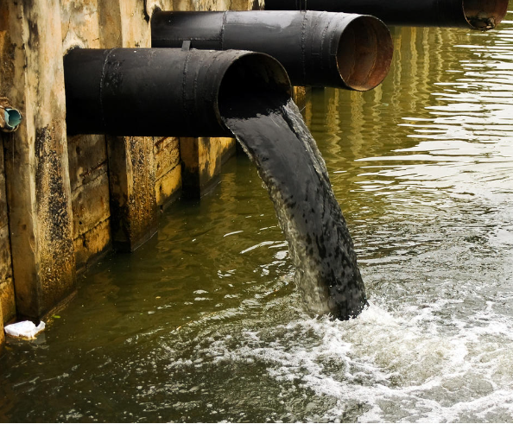
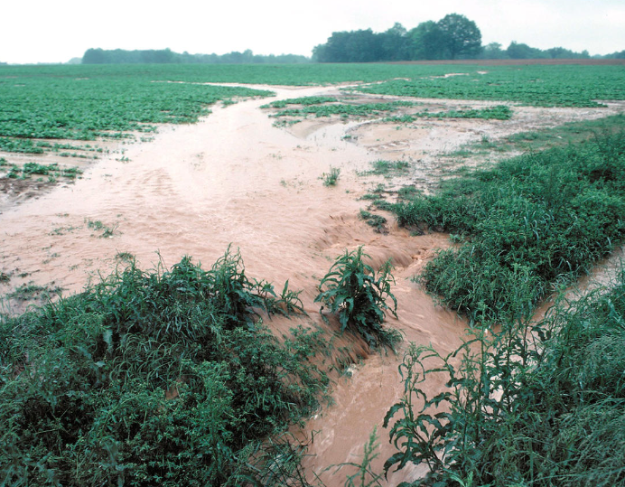
The Federal Clean Water Act (CWA) provides a framework for managing water pollution.
1948
Water Pollution Control Act
1972
Amendments to 1948 law result in Clean Water Act
1977 & 1987
Amendments to CWA create NPS Program

Slide 8
Water quality standards and monitoring are integrated with watershed restoration plans.
Water Quality Standards
Impaired waters
Total Maximum Daily Load
Nine Key Element Watershed Plan
Water Quality Monitoring

Slide 9
Geographic focus helps to prioritize watershed restoration and protection.

Slide 10
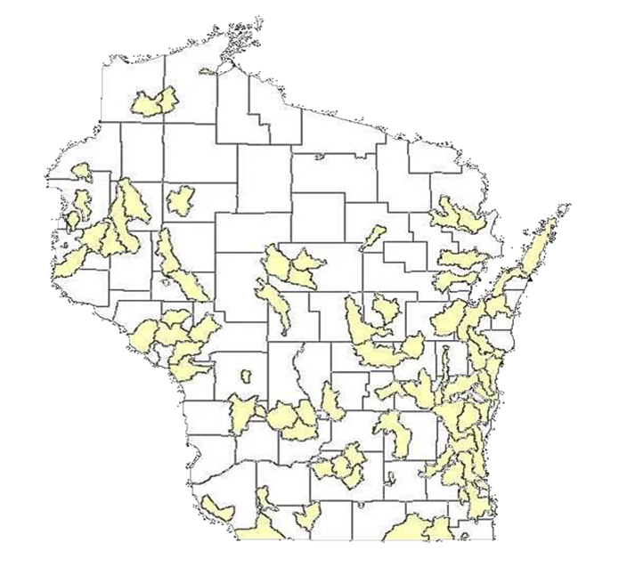
WI History, 1978: Wisconsin establishes state NPS Pollution Abatement Program.
Priority Watershed & Lakes Program
NPS pollution control plans at watershed scale
Voluntary + critical sites
Cost-sharing and local staff funding
Successful program, ended in 2009

Slide 11
WI History, 1997-1999: NPS program redesign.
Act 27 (1997)
Develop agricultural and non-agricultural performance standards (NR 151).
Implement manure management prohibitions.
Act 9 (1999)
Funding to facilitate the NPS program redesign.
Outcomes
Defined agencies’ roles and assigned implementation responsibility to local governments.
Established staffing grants for counties, defined cost-share requirements, and created TRM grants.

Slide 12
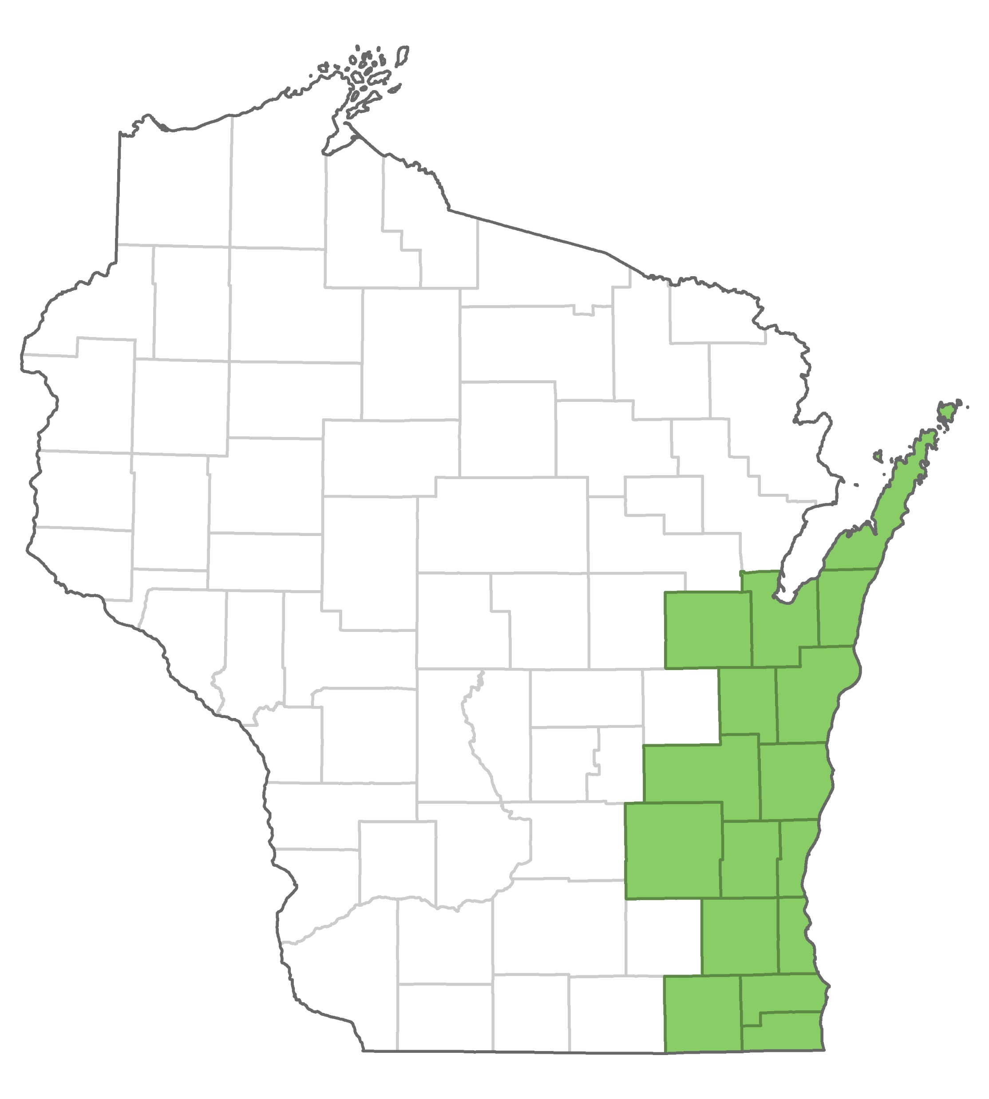
Chapter NR 151, Wisconsin Administrative Code: Runoff Management.
2002
Performance standards and prohibitions for all agricultural operations
2010
Additional standards and prohibitions.
2018
Targeted performance standard for Silurian bedrock areas.

Slide 13
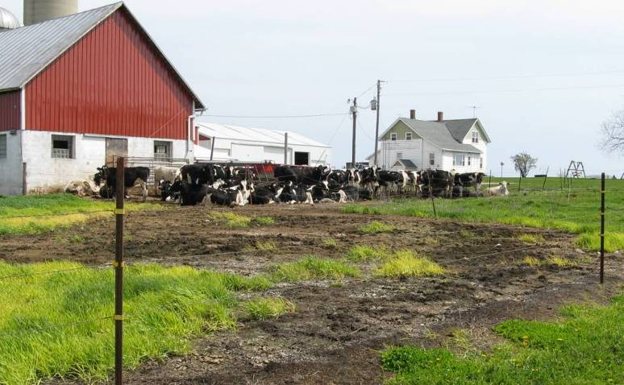
Agricultural performance standards in NR 151 include:
Sheet, rill, and wind erosion
Tillage setback
Phosphorus index
Manure storage facilities
Process wastewater handling
Clean water diversions
Nutrient management

Slide 14
Manure management prohibitions in NR 151 include:
No overflow of manure storage facilities
No unconfined manure pile in a water quality management area
No direct runoff from a feedlot or stored manure to waters of the state
No unlimited access by livestock to waters of the state

Slide 15
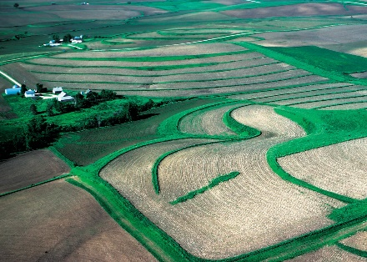
Compliance with standards is required in perpetuity.
Once compliance is achieved, cropland and/or livestock facilities must maintain compliance with the performance standards and prohibitions in perpetuity, regardless of future cost-sharing.
Depending on farm status, cost-sharing may be required.

Slide 16
County land conservation departments lead implementation of the performance standards.
County approaches include:
Ordinances
Memoranda of understanding with DNR
Land and water resource management plans
Support is provided by DNR and DATCP.

Slide 17
Agricultural performance standards
Standard | Performance Standards |  | Prohibitions | Scope |  | Reference
 | Cropland | Livestock |  | Statewide | Targeted
Soil erosion | X |  |  | X |  | 151.02
Tillage setback | X |  |  | X |  | 151.03
Phosphorus index | X |  |  | X |  | 151.04
Nutrient management | X |  |  | X |  | 151.07
Silurian bedrock | X |  |  |  | X | 151.075
Manure storage |  | X |  | X |  | 151.05
Process wastewater |  | X |  | X |  | 151.055
Clean water diversion |  | X |  | X |  | 151.06
Manure management |  |  | X | X |  | 151.08

Slide 18
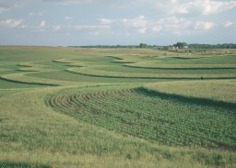
Notice of Discharge program addresses agricultural runoff.
Notice of Discharge (NOD) program started in 1984.
Addresses direct discharges from agricultural operations to waters of the state.
Farms with less than 1,000 animal units
Cost-share funding may be available
Joint implementation:
Counties provide technical assistance
DNR leads enforcement process

Slide 19
Targeted Runoff Management and Urban NPS & Storm Water Management grants:
Targeted Runoff Management (TRM)
Control agricultural or urban NPS pollution at site (up to $225,000) or watershed (up to $600,000) scales
Implement performance standards or total maximum daily load
Urban NPS & Storm Water Management
Construction – Up to $150,000 for best management practices (BMPs) to control urban NPS and storm water runoff
Planning – Up to $85,000 to complete urban runoff planning activities

Slide 20
TRM grant types and categories:
Non-TMDL
NR 151 Compliance
TMDL
Implementation
Large-Scale
Non-TMDL
Large-Scale
TMDL
Small-Scale
Non-TMDL
Small-Scale
TMDL
Large-Scale
Project
Small-Scale
Project

Slide 21
NPS grantees use BMP Implementation Tracking System (BITS) for reporting.
Governmental unit receives NPS grant from DNR
Governmental unit implements BMPs in accordance with their grant agreement
Governmental unit uses BITS to submit Final Report of implemented BMPs
Governmental unit submits reimbursement request

Slide 22
DNR nonpoint source regional coordinators
Terry Kafka
715-498-0432
Terence.Kafka@wisconsin.gov
Ruth King
715-416-0266
Ruth.King@wisconsin.gov
Temporary vacancy
Erin or Mike Gilbertson
Mike.Gilbertson@wisconsin.gov
Liz Usborne
715-590-2877
Elizabeth.Usborne@wisconsin.gov
Erin Hanson
920-360-7845
ErinE.Hanson@wisconsin.gov
Cindy Koperski
608-792-3725
Cindy.Koperski@wisconsin.gov
Jesse Bennett
414-458-0448
Jessiah.Bennett@wisconsin.gov
Temporary vacancy
Cindy, Jesse or Mike Gilbertson
Mike.Gilbertson@wisconsin.gov
UNPS grants: Dan Bekta, 608-333-6579, Eugene.Bekta@wisconsin.gov
https://dnr.wisconsin.gov/topic/Nonpoint/NPScontacts.html

Slide 23
Thank you.
Karl Gesch
karl.gesch@wisconsin.gov
608-630-1171
https://dnr.wisconsin.gov/topic/Nonpoint

